Slide 1
Advanced Systems Analysis and Design User Interface Design SOFT 30121 L12

Slide 2

User Interface design
RecoSystems Analysis and Design
Alan Dennis; Barbara Haley Wixom; Roberta M. Roth
2019
Chapter 8

Slide 3
User Interface Design
Objectives of Lecture 12
Identify and describe the five basic rules of user interface design.
Describe the concept of usability with respect to a system's user interface.
Why is this concept important to the interface designer?
Explain three unique aspects of designing for a touch screen user interface.
Discuss the five components of the user interface design process.
Explain the particular issues associated with design of the system's navigation mechanism.
Discuss ways to improve the quality of input data captured by the system.
Explain the best ways to produce output from the system

Slide 4
Introduction
The user interface includes three fundamental parts.
The first is the navigation mechanism, the way in which the user gives instructions to the system and tells it what to do (e.g., buttons, menus).
The second is the input mechanism, the way in which the system captures information (e.g., forms for adding new customers).
The third is the output mechanism, the way in which the system provides information to the user (e.g., reports). Each of these is conceptually different, but are closely related.
User interface screens typically always contain some navigation mechanisms, and most contain input and/or output mechanisms. Therefore, navigation design, input design, and output design are tightly coupled.

Slide 5
Usability
The term usability encompasses two related concepts: systems that
are easy to use and
easy to learn.
When a system's user interface is very usable, users will be more likely to use the system, an important consideration when using the system is optional.

Slide 6
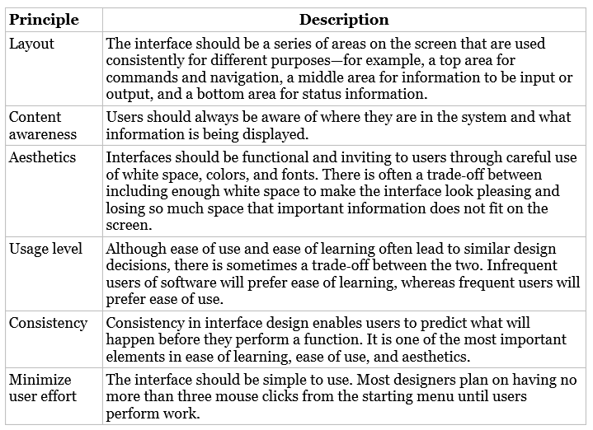
Principles for User Interface Design

Slide 7
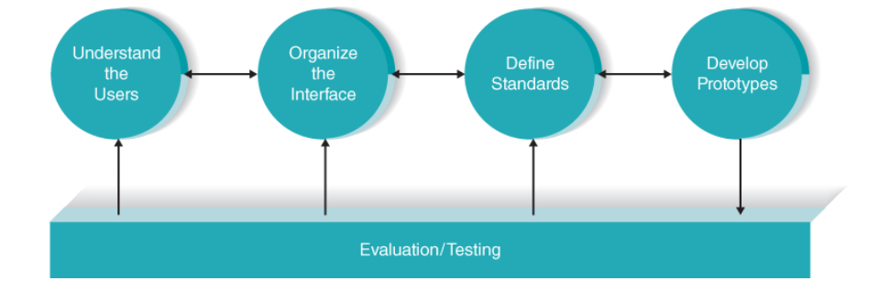
User Interface Design Process
Identified user groups can be represented with personas. The most common usage patterns of the system are depicted with use scenarios so that the interface can enable users to quickly and smoothly perform these scenarios.
Second, the analysts organize the interface using a variety of tools, such as the interface structure diagram (ISD) and site map.
Third, the analysts design interface standards, which are the basic design elements on which interfaces in the system are based.

Slide 8
User Interface Design Process
Fourth, the analysts create an interface design prototype for each of the individual interfaces in the system, such as navigation controls, input screens, output screens, forms (including preprinted paper forms), and reports. Prototypes can take a variety of forms, including storyboards, wireframe diagrams, wireflow diagrams, and more realistic models.
Finally, the individual interfaces are subjected to interface evaluation/testing to determine whether they are satisfactory and how they can be improved.

Slide 9
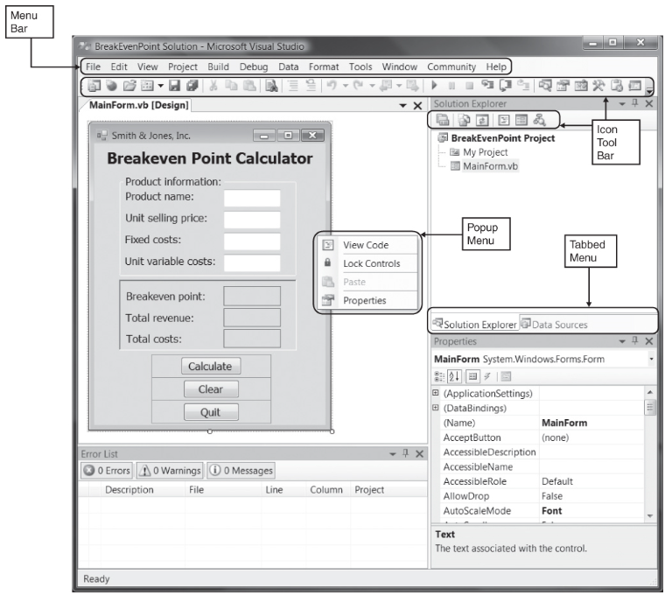
Navigation Design

Slide 10
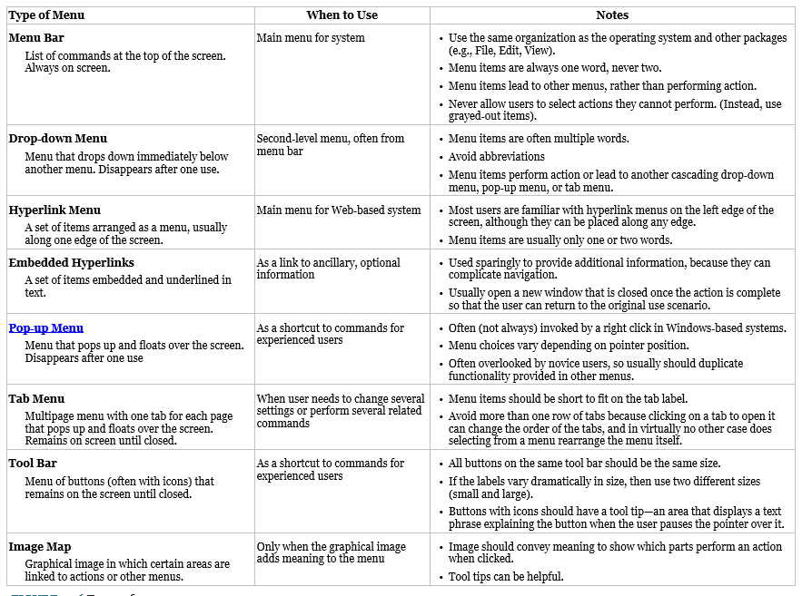
Navigation Design

Slide 11
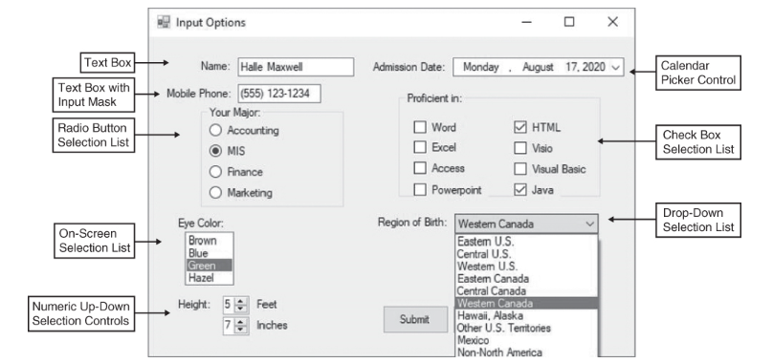
Input Design

Slide 12
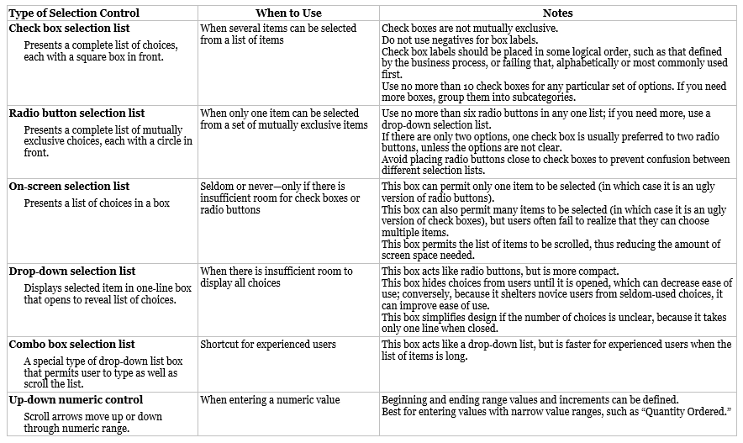
Input Design

Slide 13
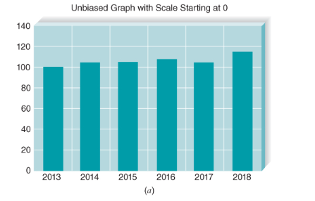
Output Design
Outputs are the reports that the system produces, whether on the screen, on paper, or in other media, such as the Web. Outputs are perhaps the most visible part of any system, because a primary reason for using an information system is to access the information that it produces.
Basic Principles
The goal of the output mechanism is to present information to users so that they can accurately understand it with the least effort. The fundamental principles for output design reflect how the outputs are used and ways to make it simpler for users to understand them.

Slide 14
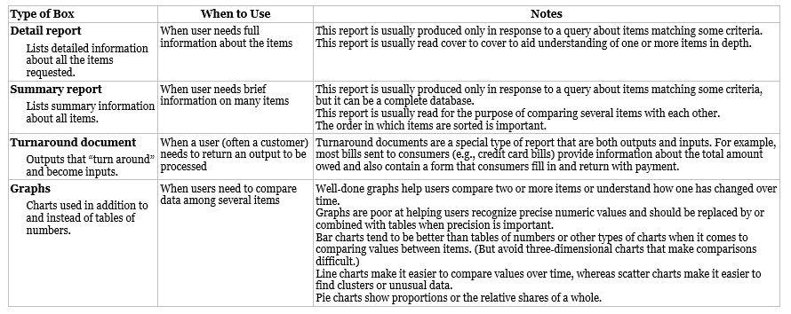
Output Design

Slide 15
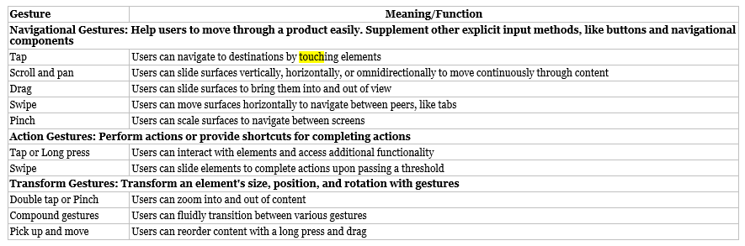
Touch Screen
The keyboard and mouse have ruled the user interaction domain for decades, but recent advances in multitouch technology have changed the game. The iPhone and iPad paved the way for touch screen interfaces on all sorts of devices. The natural and simple interaction enabled by touch screens is appealing but does add several important new considerations to user interface design. In general, applications involving significant data entry are not ideal for the touch screen environment. The optimal use of touch screens is to retrieve and display information rather than enter new data.
Common set of gestures supported by Android devices

Slide 16
Touch Screens
Considerations
When using a finger to interact with the application, the finger obscures some of the content on the screen
Whenever possible, use graphical objects that can be manipulated rather than entering text
With touch screens, hand gestures are used to directly interact with the interactive elements on the screen. It is no longer possible to provide information to the user through hovering and tool tips.
If you use a standard CSS Library these issues will have been taken care of.

Slide 17
Chapter Review
After reading and studying this chapter, you should be able to:
Identify and describe the five basic rules of user interface design.
Describe the concept of usability with respect to a system's user interface. Why is this concept important to the interface designer?
Explain three unique aspects of designing for a touch screen user interface.
Discuss the five components of the user interface design process.
Explain the particular issues associated with design of the system's navigation mechanism.
Discuss ways to improve the quality of input data captured by the system.
Explain the best ways to produce output from the system.

Slide 18
Nigel’s View of User Interface Design
Sketch and review. Don’t do major works of art.
Mace Sports 5 minute demo
I prefer low fidelity design tools
Ninja Mock 5 minute demo
Balsamiq 5 minute demo
Balsamic and Ninjamock give you a pallet of UI Widgets that are consistent with UI conventions. Too much creativity decreases familiarity.
When you get to build, CSS Frameworks such as Bootstrap and Foundation will have components for you

Slide 19
Nigel’s View of User Interface Design
Paper and Pen and photographs works well for 1 or 2 pages, but as your design grows a sketching tool is productive.
I positively hate using Visio for page design but it can be helpful to layout the overall page flow
Sketch in something easy to sketch in
Customers / Senior management gets to review the product concept without thinking we are done.

Slide 20
Nigel’s View of User Interface Design
Test Usability early and often
You can test usability with conceptual UI’s
Task Completion Rates
Assistance Rates
Assisted Completion Rates
These metrics tell you a lot about how much guidance should be embedded in the UI.
I was a test subject for Oracle’s first webstore and it was screen designs on paper and a block of wood for a pointer.

Slide 21
Nigel’s View of User Interface Design
UI Mockups have helped me develop my seed data, demo data, demo flows, sales training, so I can hit the ground running when the code is ready.
I have sold plenty of software based on UI Mockups

Slide 22
Next Lecture
Program Design

